Slide 1


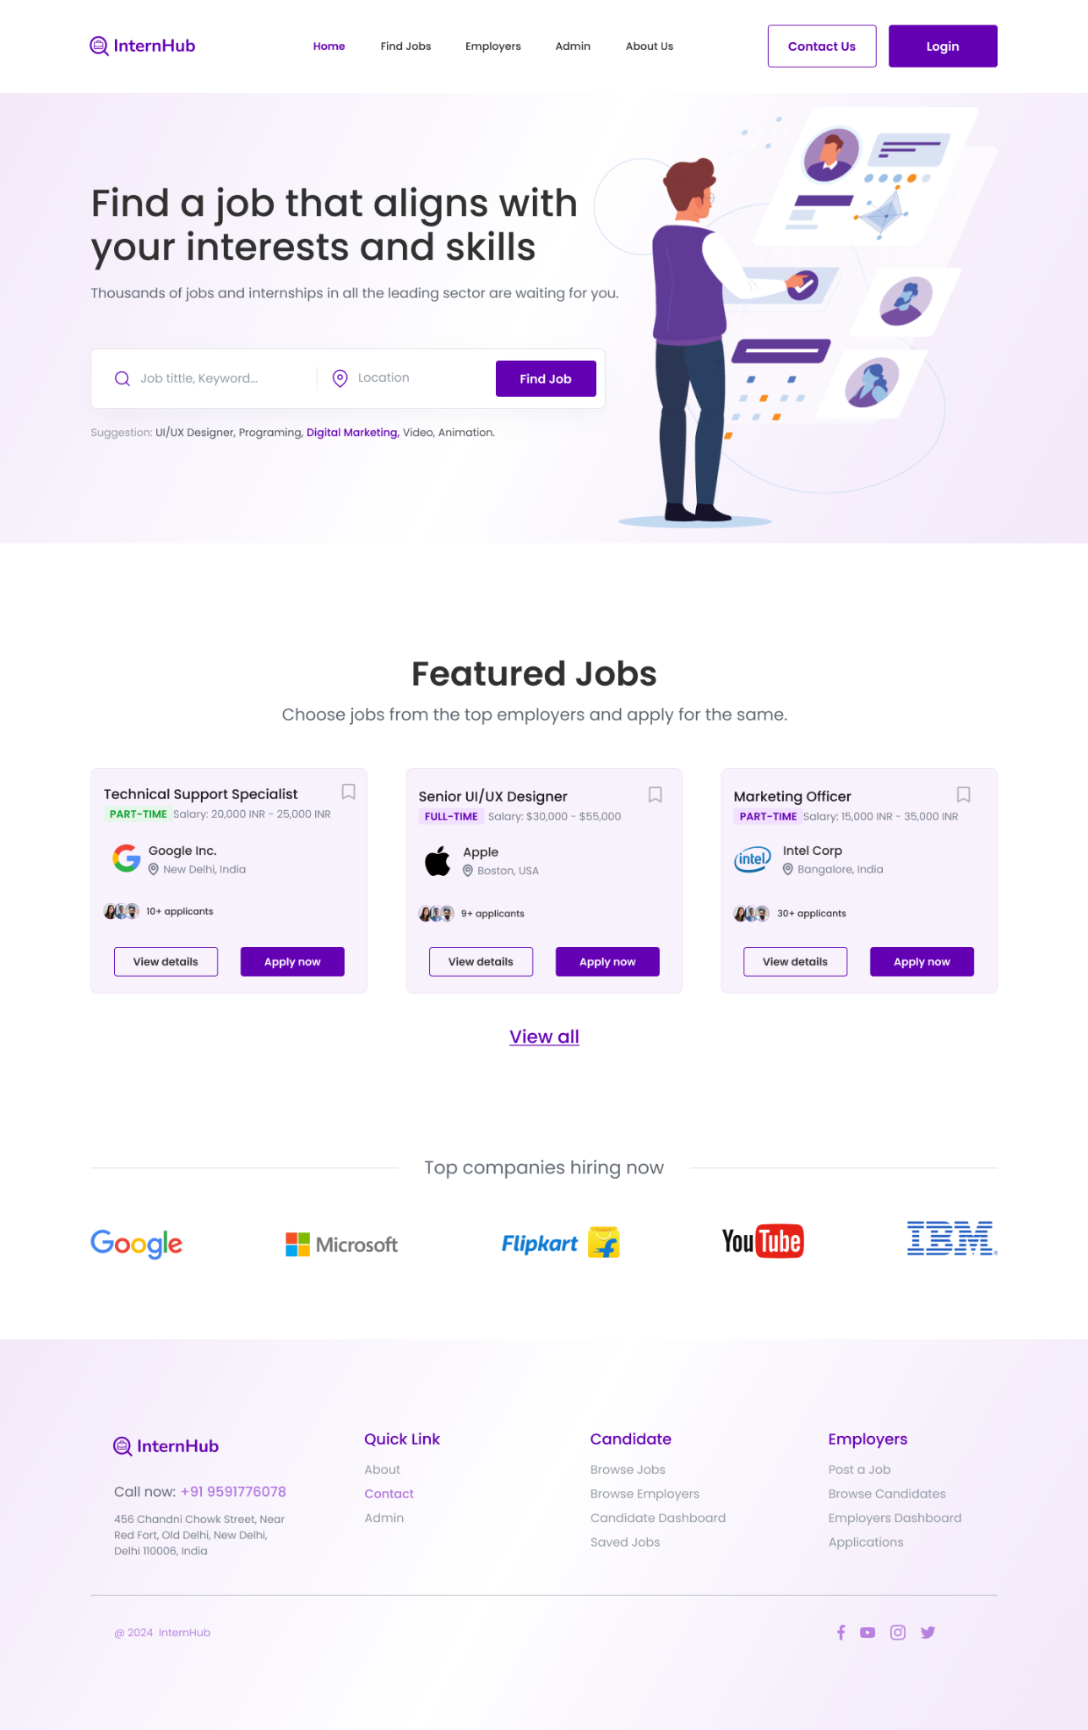
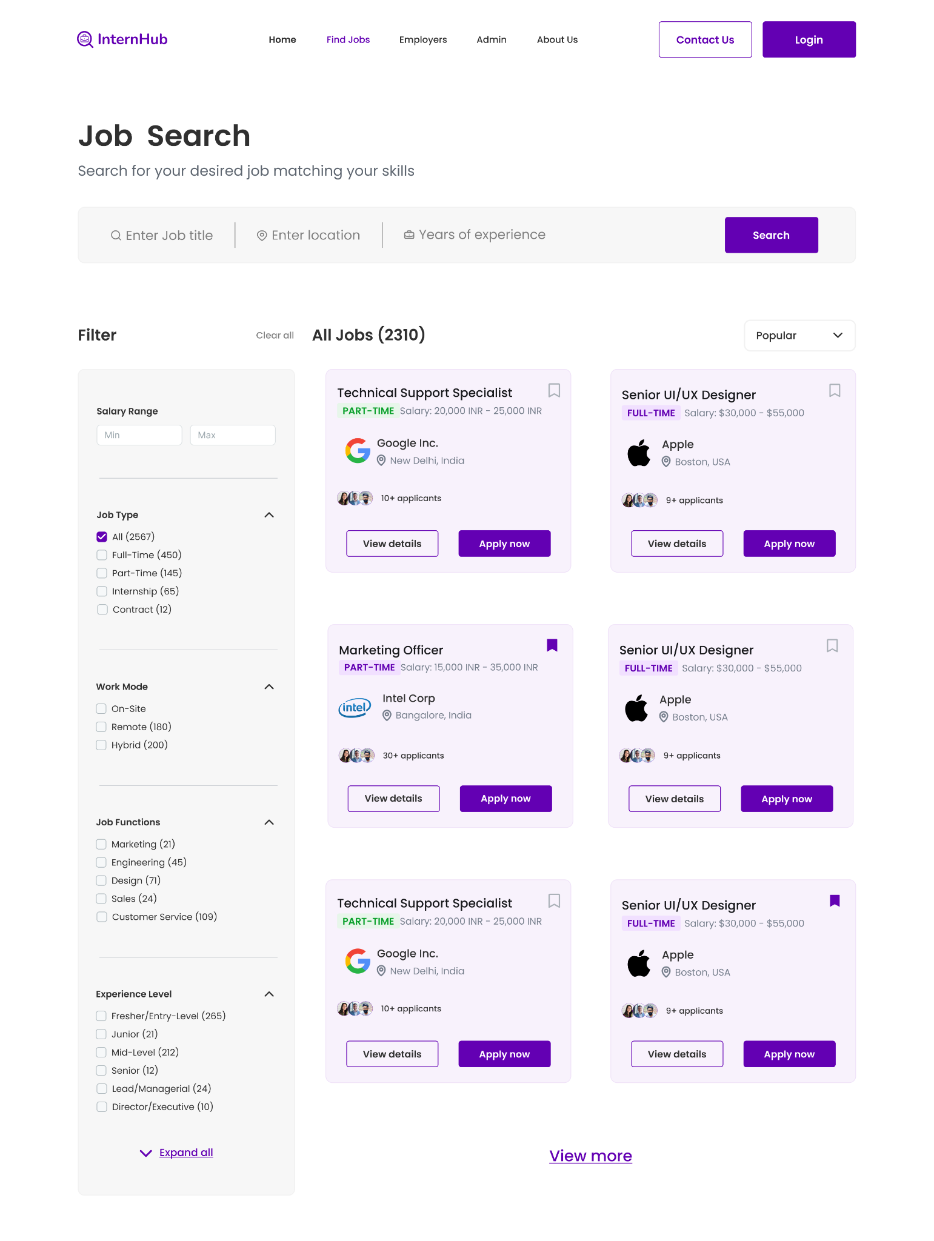
FACULTY OF ENGINEERING & TECHNOLOGY K J SOMAIYA SCHOOL OF ENGINEERING DEPARTMENT OF COMPUTER ENGINEERING
Title: InternHub
Student Name: Ninad Marathe , Aakriti Mehta , Aayush Mehta Under the guidance of : Deepa Jain
Course Name: Mern Year: 2024-25
1. Introduction
The InternHub project is designed to provide a seamless platform that connects job seekers (interns/freelancers) with employers (companies). The platform offers a user-friendly interface for job postings, applications, and hiring processes. It aims to enhance the interaction between recruiters and applicants by simplifying profile creation, job browsing, and application submission, ensuring a smooth experience for both parties.
Implementation The project utilizes a tech stack comprising React JS with MUI for the frontend, Node.js for backend services, and MongoDB for data storage. It features multiple collections for managing users, jobs, recruiters, and intern profiles. Key functionalities include user authentication, job posting, profile management, and file uploads. RESTful APIs enable seamless communication between the frontend and backend.
Technology Stack Front-end: React JS, MUI (Material UI for styling)
Back-end: Node.js
Database: MongoDB (NoSQL)
Development Tools: GitHub for version control, Figma for design, VS Code for development
Results
The InternHub platform successfully integrates key features that allow job seekers and employers to interact seamlessly. The project was able to:
Streamline job posting and job application processes.
Provide efficient user account management (for both companies and freelancers/interns).
Implement functionality for uploading and managing resumes and files.
Ensure smooth operation through successful database connectivity and data management.
The platform demonstrated its capability to facilitate communication between job seekers and employers, laying the foundation for future scalability.
Objective
The main objective of InternHub is to create a platform where employers can post jobs and job seekers can apply easily. The project aims to provide a system that offers efficient account management, easy job listing and browsing, and a smooth application process for both companies and interns/freelancers. The focus is on user experience, making it intuitive for both clients and applicants to interact with the platform…
System Design :
User Authentication: Implemented using JSON Web Tokens (JWT) for secure login and session management.
Data Management: MongoDB was chosen due to its ability to handle dynamic data structures, with separate collections for users, jobs, applications, recruiter profiles, and intern profiles.
REST API: Node.js was used to create REST APIs that facilitate communication between the front-end and the MongoDB database.
File Storage: Resumes and other files are managed using references to file storage, with the capability to handle various file formats and sizes.
Testing Results
Authentication: Users successfully signed up and logged in, with proper validation for email and password inputs. Incorrect login attempts were handled with appropriate error messages.
Job Posting & Application: Employers could post jobs, and interns applied seamlessly. Job status (e.g., Listing, Closed) was reflected accurately, and resume uploads worked as expected.
File Upload: File formats were validated, and uploaded resumes were properly linked to user profiles.
Database Interaction: Data for users, jobs, and applications was stored correctly in MongoDB, ensuring consistency between collections.
Github and Figma Links : https://www.figma.com/design/ByrFWWZzebVfxa4LsEKH2q/Internhub?node-id=0-1&t=sNqKCKjvMLHeBcDn-1 https://github.com/aakritim15/InternHub
Notes:
Copyright Colin Purrington (http://colinpurrington.com/tips/academic/posterdesign).
‹#›

